Slide 1
Regression
Md. Ismail Hossain Riday

Slide 2
Regression
Relationship between two or more variables

Slide 3
Regression
Relationship between two or more variables
Cause and effect relationship

Slide 4
Regression
Relationship between two or more variables
Cause and effect relationship
Casual variables vs Affected variables

Slide 5
Regression
Relationship between two or more variables
Cause and effect relationship
Casual variables vs Affected variables
Causal variables as independent variables; affected variables as dependent variables

Slide 6
Regression
Relationship between two or more variables
Cause and effect relationship
Casual variables vs Affected variables
Causal variables as independent variables; affected variables as dependent variables

Slide 7


Regression
$$Dependent variable = Y$$
$$Independent variable =X$$
Regression refers to the cause-and-effect relationship between two or more variables, where affected variables are dependent variables and causal variables are independent variables.
This relationship is mathematically expressed, highlighting the impact of independent variables on dependent variables.

Slide 8
Correlation vs Regression
Correlation | Regression
1. Correlation is a statistical measure that determines the association between two variables. | 1. Regression describe how to numerically relate an independent variable to the dependent variable.
2. There is no dependent variable and independent variable. | 2. Must be one dependent variable and one independent variable.
3. To represent the linear relationship between variables. | 3. To represent the cause and effect relationship between variables.

Slide 9
Types of Regression
On the basis of variables

Slide 10
Types of Regression
On the basis of variables (two types)
Simple regression
One dependent vs one independent
Multiple regression
One dependent vs multiple independent

Slide 11
Types of Regression
On the basis of variables (two types)
Simple regression
One dependent vs one independent
Multiple regression
One dependent vs multiple independent

Slide 12
Types of Regression
On the basis of variables (two types)
Simple regression
One dependent vs one independent
Multiple regression
One dependent vs multiple independent

Slide 13
Types of Regression
On the basis of variables (two types)
Simple regression
One dependent vs one independent
Multiple regression
One dependent vs multiple independent

Slide 14
Types of Regression
On the basis of variables (two types)
Simple regression
One dependent vs one independent
Multiple regression
One dependent vs multiple independent

Slide 15
Types of Regression
On the basis of variables (two types)
Simple regression
One dependent vs one independent
Multiple regression
One dependent vs multiple independent

Slide 16

Simple regression
One dependent variable vs One independent variable
Expressed this relationship as a mathematical form
The mathematical form is,
$$Y_{i}=α+βX_{i}+ε_{i} ;i=1,2,3,…,n$$
Here,
$Y_{i}=Dependent variable$
$X_{i}=Independent variable$
$α=Intercept coefficient$
$β=Slope coefficient$
$ε_{i}=Error term$

Slide 17

Simple regression
One dependent variable vs One independent variable
Expressed this relationship as a mathematical form
The mathematical form is,
$$Y_{i}=α+βX_{i}+ε_{i} ;i=1,2,3,…,n$$
Here,
$Y_{i}=Dependent variable$
$X_{i}=Independent variable$
$α=Intercept coefficient$
$β=Slope coefficient$
$ε_{i}=Error term$

Slide 18

Simple regression
One dependent variable vs One independent variable
Expressed this relationship as a mathematical form
The mathematical form is,
$$Y_{i}=α+βX_{i}+ε_{i} ;i=1,2,3,…,n$$
Here,
$Y_{i}=Dependent variable$
$X_{i}=Independent variable$
$α=Intercept coefficient$
$β=Slope coefficient$
$ε_{i}=Error term$

Slide 19
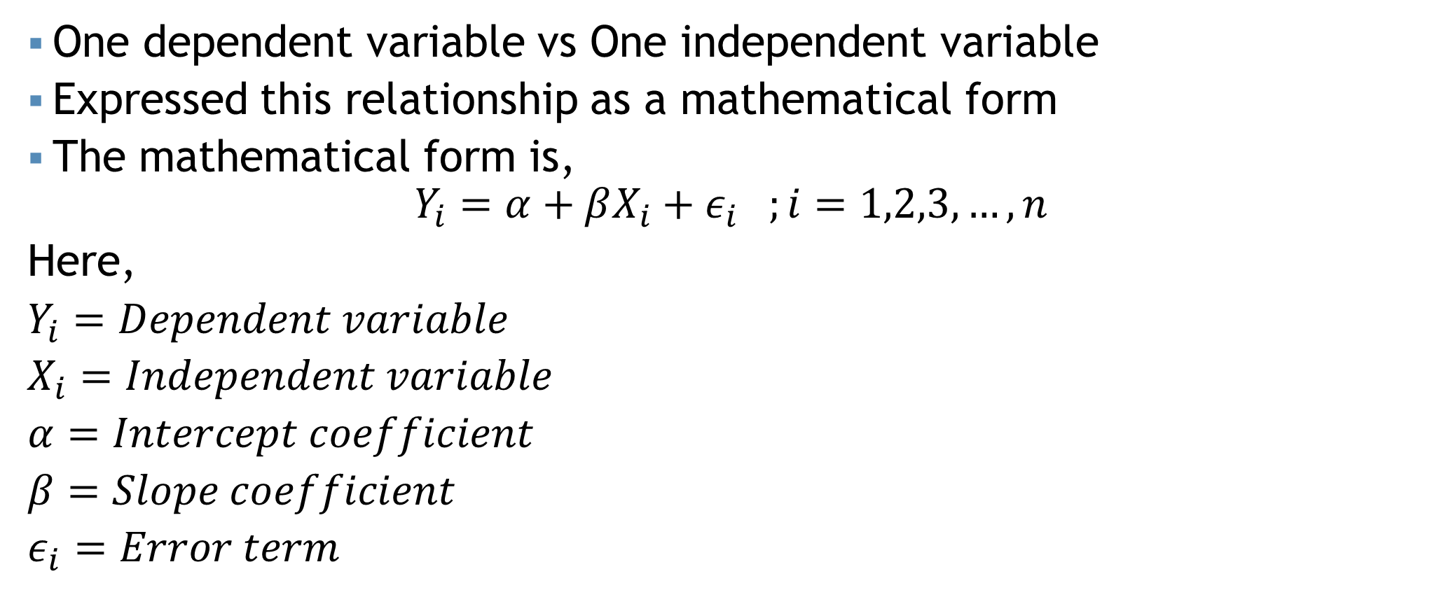
Simple regression
One dependent variable vs One independent variable
Expressed this relationship as a mathematical form
The mathematical form is,
$$Y_{i}=α+βX_{i}+ε_{i} ;i=1,2,3,…,n$$
Here,
$Y_{i}=Dependent variable$
$X_{i}=Independent variable$
$α=Intercept coefficient$
$β=Slope coefficient$
$ε_{i}=Error term$

Slide 20
Simple regression
One dependent variable vs One independent variable
Expressed this relationship as a mathematical form
The mathematical form is,
$$Y_{i}=α+βX_{i}+ε_{i} ;i=1,2,3,…,n$$
Here,
$Y_{i}=Dependent variable$
$X_{i}=Independent variable$
$α=Intercept coefficient$
$β=Slope coefficient$
$ε_{i}=Error term$
Multiple regression: $Y=α+β_{1}X_{1}+…+β_{k}X_{k}+ε$

Slide 21
Simple regression

Slide 22

Simple regression
$$Y_{i}=α+βX_{i}+ε_{i}$$

Slide 23
Simple regression
$$Y_{i}=α+βX_{i}+ε_{i}$$

Slide 24
Simple regression
$$Y_{i}=α+βX_{i}+ε_{i}$$

Slide 25
Simple regression
$$Y_{i}=α+βX_{i}+ε_{i}$$
Error term

Slide 26
Simple regression
$$Y_{i}=α+βX_{i}+ε_{i}$$
Error term
Regression parameter

Slide 27
Estimating parameters
Estimating regression parameters:
Least square method
Graphical method

Slide 28
Estimating parameters
Estimating regression parameters:
Least square method
Graphical method

Slide 29

Estimating parameters
$$Y_{i}=α+βX_{i}+ε_{i}$$
Let the estimator of $α$ and $β$ is $\hat{α}$ and $\hat{β}$.

Slide 30

Estimating parameters
$$Y_{i}=α+βX_{i}+ε_{i}$$
Let the estimator of $α$ and $β$ is $\hat{α}$ and $\hat{β}$.
$\hat{β}=\frac{\sum{\left(x_{i}−\overline{x}\right)\left(y_{i}−\overline{y}\right)}}{\sum{{\left(x_{i}−\overline{x}\right)}^{2}}}=\frac{n\sum{x_{i}y_{i}}−\sum{x_{i}\sum{y_{i}}}}{n\sum{x_{i}^{2}}−{\left(\sum{x_{i}}\right)}^{2}}$

Slide 31

Estimating parameters
$$Y_{i}=α+βX_{i}+ε_{i}$$
Let the estimator of $α$ and $β$ is $\hat{α}$ and $\hat{β}$.
$\hat{β}=\frac{\sum{\left(x_{i}−\overline{x}\right)\left(y_{i}−\overline{y}\right)}}{\sum{{\left(x_{i}−\overline{x}\right)}^{2}}}=\frac{n\sum{x_{i}y_{i}}−\sum{x_{i}\sum{y_{i}}}}{n\sum{x_{i}^{2}}−{\left(\sum{x_{i}}\right)}^{2}}$
$\hat{α}=\overline{y}−\hat{β}\overline{x}$

Slide 32

Estimating parameters
Let the estimator of $α$ and $β$ is $\hat{α}$ and $\hat{β}$.
$\hat{β}=\frac{\sum{\left(x_{i}−\overline{x}\right)\left(y_{i}−\overline{y}\right)}}{\sum{{\left(x_{i}−\overline{x}\right)}^{2}}}=\frac{n\sum{x_{i}y_{i}}−\sum{x_{i}\sum{y_{i}}}}{n\sum{x_{i}^{2}}−{\left(\sum{x_{i}}\right)}^{2}}$
$\hat{α}=\overline{y}−\hat{β}\overline{x}$
$$\hat{Y_{i}}=\hat{α}+\hat{β}X_{i}$$

Slide 33
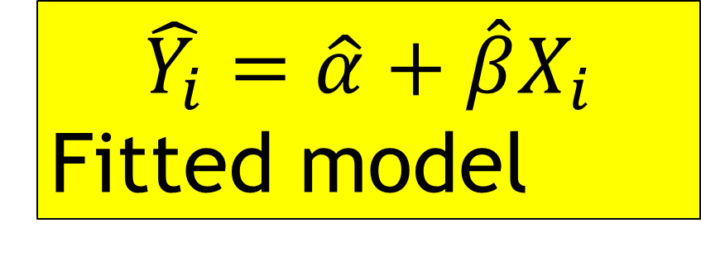
Estimating parameters
Let the estimator of $α$ and $β$ is $\hat{α}$ and $\hat{β}$.
$\hat{β}=\frac{\sum{\left(x_{i}−\overline{x}\right)\left(y_{i}−\overline{y}\right)}}{\sum{{\left(x_{i}−\overline{x}\right)}^{2}}}=\frac{n\sum{x_{i}y_{i}}−\sum{x_{i}\sum{y_{i}}}}{n\sum{x_{i}^{2}}−{\left(\sum{x_{i}}\right)}^{2}}$
$\hat{α}=\overline{y}−\hat{β}\overline{x}$
$$\hat{Y_{i}}=\hat{α}+\hat{β}X_{i}$$
Fitted model

Slide 34

Example
Advertising cost ($ million) | Sales revenue ($ million)
2 | 7
1 | 3
3 | 8
4 | 10
Draw the scatter diagram.
Determine the fitted regression model.
Interpret the regression parameter.
Estimate sales revenue when advertising cost is $9.
$$\hat{Y_{i}}=\hat{α}+\hat{β}X_{i}$$

Slide 35
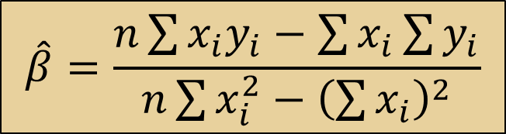
Example
$$\hat{β}=\frac{n\sum{x_{i}y_{i}}−\sum{x_{i}\sum{y_{i}}}}{n\sum{x_{i}^{2}}−{\left(\sum{x_{i}}\right)}^{2}}$$

Slide 36
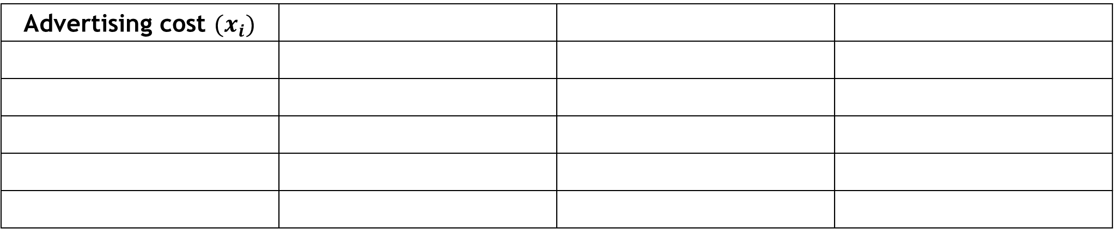
Example
$$\hat{β}=\frac{n\sum{x_{i}y_{i}}−\sum{x_{i}\sum{y_{i}}}}{n\sum{x_{i}^{2}}−{\left(\sum{x_{i}}\right)}^{2}}$$
Advertising cost $(x_{i})$

Slide 37
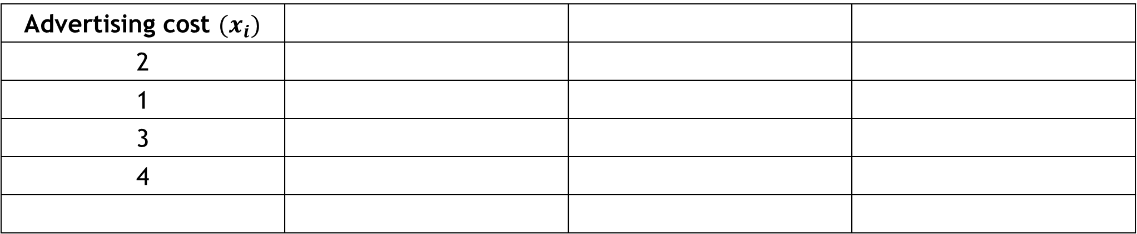
Example
$$\hat{β}=\frac{n\sum{x_{i}y_{i}}−\sum{x_{i}\sum{y_{i}}}}{n\sum{x_{i}^{2}}−{\left(\sum{x_{i}}\right)}^{2}}$$
Advertising cost $(x_{i})$
2
1
3
4

Slide 38
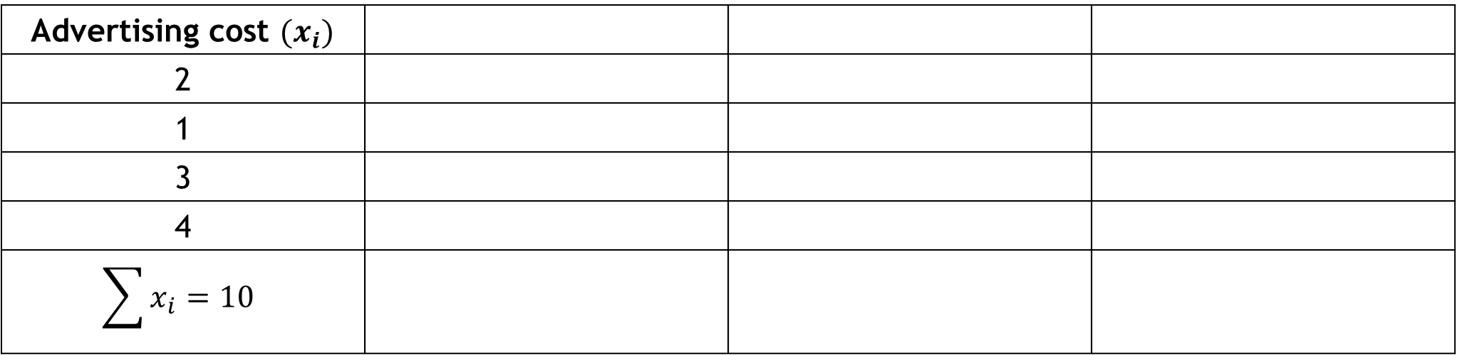
Example
$$\hat{β}=\frac{n\sum{x_{i}y_{i}}−\sum{x_{i}\sum{y_{i}}}}{n\sum{x_{i}^{2}}−{\left(\sum{x_{i}}\right)}^{2}}$$
Advertising cost $(x_{i})$
2
1
3
4
$$\sum{x_{i}}=10$$

Slide 39
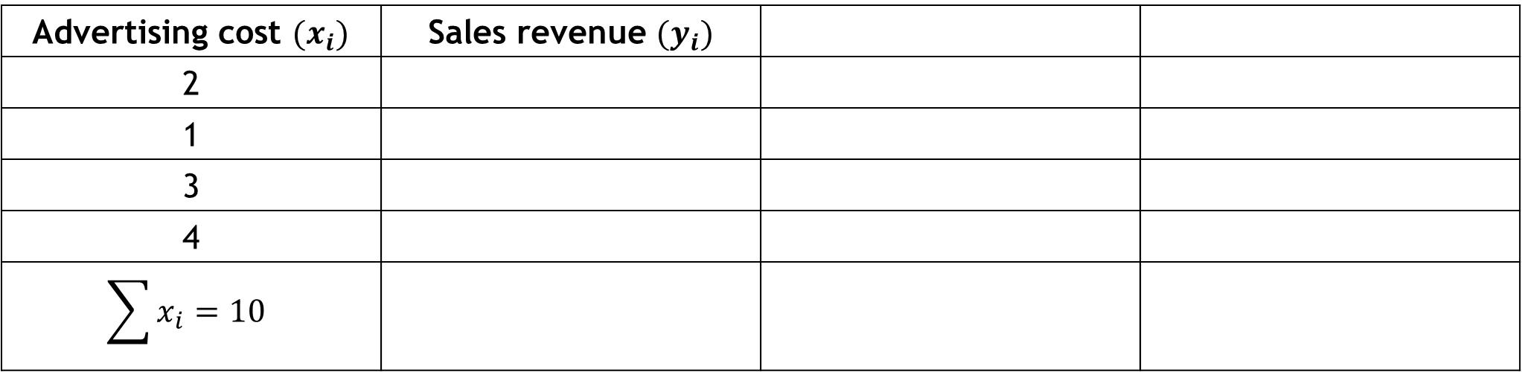
Example
$$\hat{β}=\frac{n\sum{x_{i}y_{i}}−\sum{x_{i}\sum{y_{i}}}}{n\sum{x_{i}^{2}}−{\left(\sum{x_{i}}\right)}^{2}}$$
Advertising cost $(x_{i})$ | Sales revenue $(y_{i})$
2
1
3
4
$$\sum{x_{i}}=10$$

Slide 40
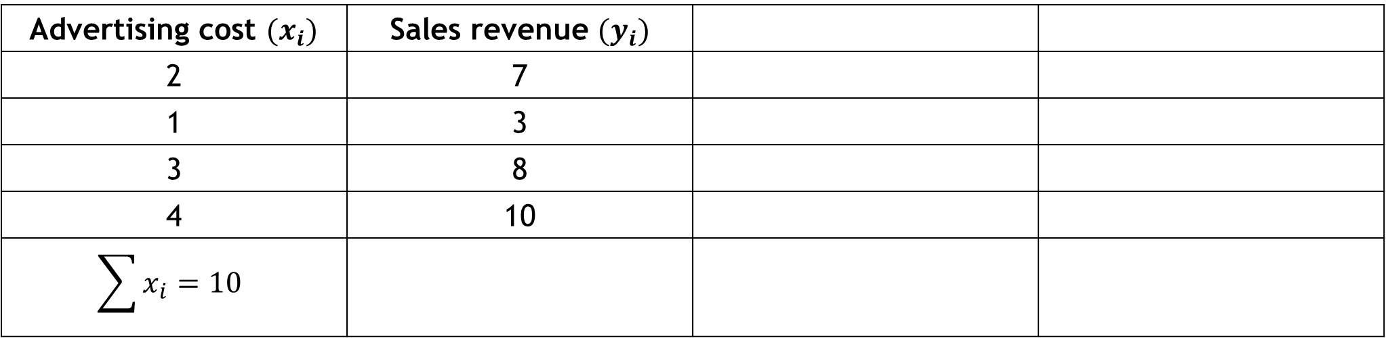
Example
$$\hat{β}=\frac{n\sum{x_{i}y_{i}}−\sum{x_{i}\sum{y_{i}}}}{n\sum{x_{i}^{2}}−{\left(\sum{x_{i}}\right)}^{2}}$$
Advertising cost $(x_{i})$ | Sales revenue $(y_{i})$
2 | 7
1 | 3
3 | 8
4 | 10
$$\sum{x_{i}}=10$$

Slide 41
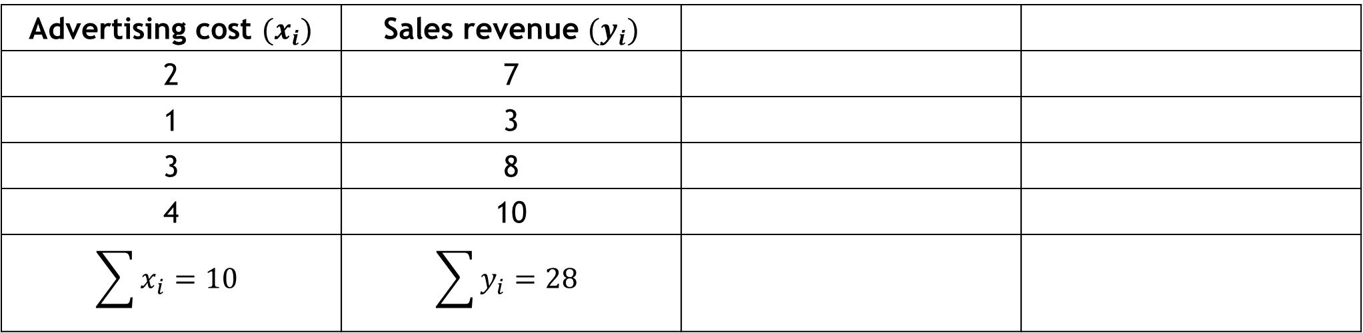
Example
$$\hat{β}=\frac{n\sum{x_{i}y_{i}}−\sum{x_{i}\sum{y_{i}}}}{n\sum{x_{i}^{2}}−{\left(\sum{x_{i}}\right)}^{2}}$$
Advertising cost $(x_{i})$ | Sales revenue $(y_{i})$
2 | 7
1 | 3
3 | 8
4 | 10
$$\sum{x_{i}}=10$$ | $$\sum{y_{i}}=28$$

Slide 42
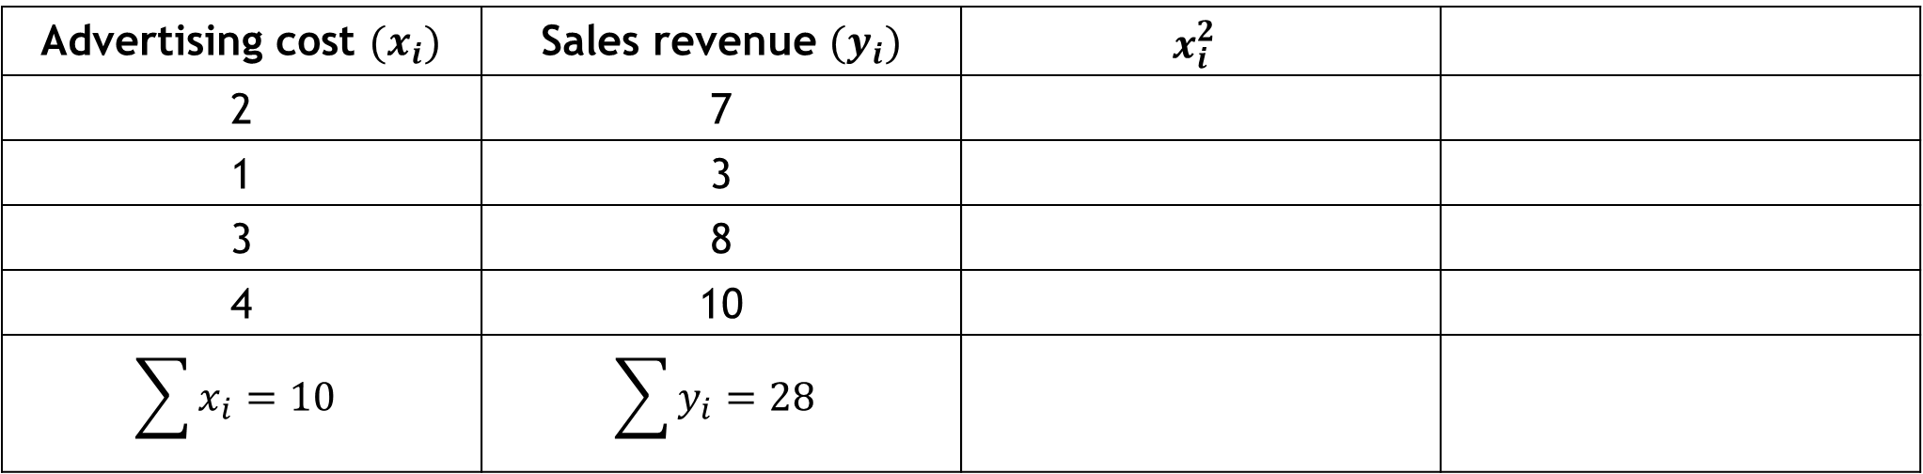
Example
$$\hat{β}=\frac{n\sum{x_{i}y_{i}}−\sum{x_{i}\sum{y_{i}}}}{n\sum{x_{i}^{2}}−{\left(\sum{x_{i}}\right)}^{2}}$$
Advertising cost $(x_{i})$ | Sales revenue $(y_{i})$ | $$x_{i}^{2}$$
2 | 7
1 | 3
3 | 8
4 | 10
$$\sum{x_{i}}=10$$ | $$\sum{y_{i}}=28$$

Slide 43
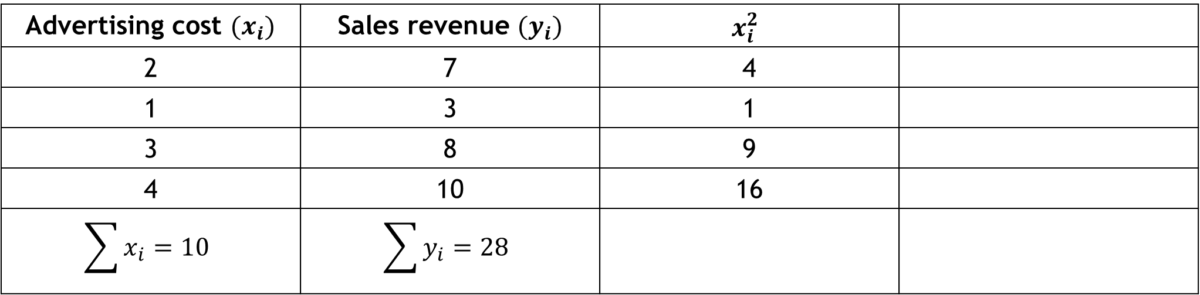
Example
$$\hat{β}=\frac{n\sum{x_{i}y_{i}}−\sum{x_{i}\sum{y_{i}}}}{n\sum{x_{i}^{2}}−{\left(\sum{x_{i}}\right)}^{2}}$$
Advertising cost $(x_{i})$ | Sales revenue $(y_{i})$ | $$x_{i}^{2}$$
2 | 7 | 4
1 | 3 | 1
3 | 8 | 9
4 | 10 | 16
$$\sum{x_{i}}=10$$ | $$\sum{y_{i}}=28$$

Slide 44
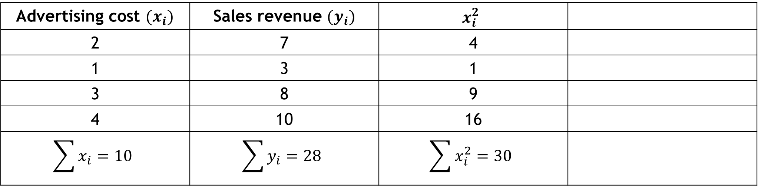
Example
$$\hat{β}=\frac{n\sum{x_{i}y_{i}}−\sum{x_{i}\sum{y_{i}}}}{n\sum{x_{i}^{2}}−{\left(\sum{x_{i}}\right)}^{2}}$$
Advertising cost $(x_{i})$ | Sales revenue $(y_{i})$ | $$x_{i}^{2}$$
2 | 7 | 4
1 | 3 | 1
3 | 8 | 9
4 | 10 | 16
$$\sum{x_{i}}=10$$ | $$\sum{y_{i}}=28$$ | $$\sum{x_{i}^{2}}=30$$

Slide 45
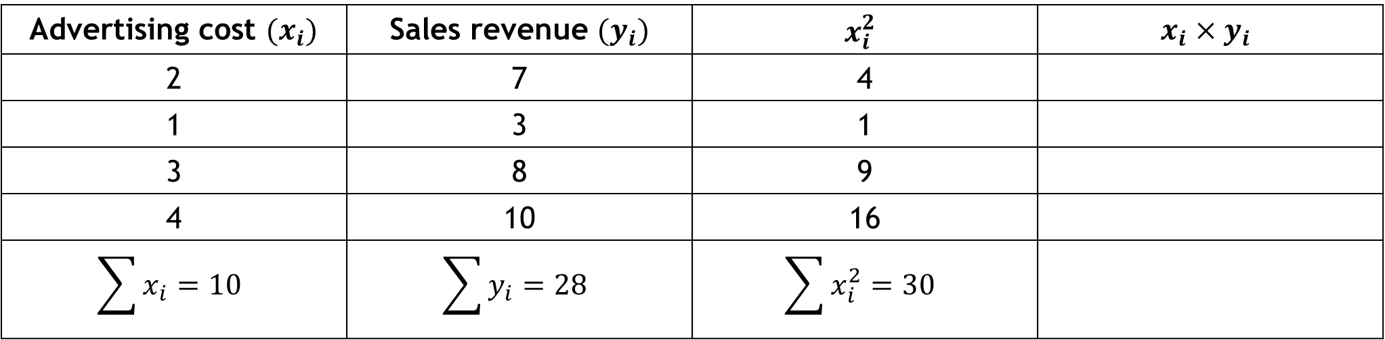
Example
$$\hat{β}=\frac{n\sum{x_{i}y_{i}}−\sum{x_{i}\sum{y_{i}}}}{n\sum{x_{i}^{2}}−{\left(\sum{x_{i}}\right)}^{2}}$$
Advertising cost $(x_{i})$ | Sales revenue $(y_{i})$ | $$x_{i}^{2}$$ | $$x_{i}×y_{i}$$
2 | 7 | 4
1 | 3 | 1
3 | 8 | 9
4 | 10 | 16
$$\sum{x_{i}}=10$$ | $$\sum{y_{i}}=28$$ | $$\sum{x_{i}^{2}}=30$$

Slide 46
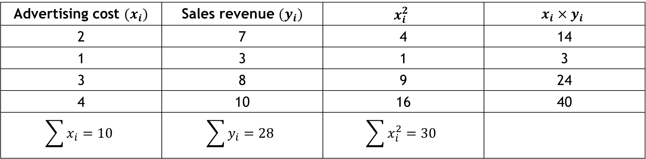
Example
$$\hat{β}=\frac{n\sum{x_{i}y_{i}}−\sum{x_{i}\sum{y_{i}}}}{n\sum{x_{i}^{2}}−{\left(\sum{x_{i}}\right)}^{2}}$$
Advertising cost $(x_{i})$ | Sales revenue $(y_{i})$ | $$x_{i}^{2}$$ | $$x_{i}×y_{i}$$
2 | 7 | 4 | 14
1 | 3 | 1 | 3
3 | 8 | 9 | 24
4 | 10 | 16 | 40
$$\sum{x_{i}}=10$$ | $$\sum{y_{i}}=28$$ | $$\sum{x_{i}^{2}}=30$$

Slide 47
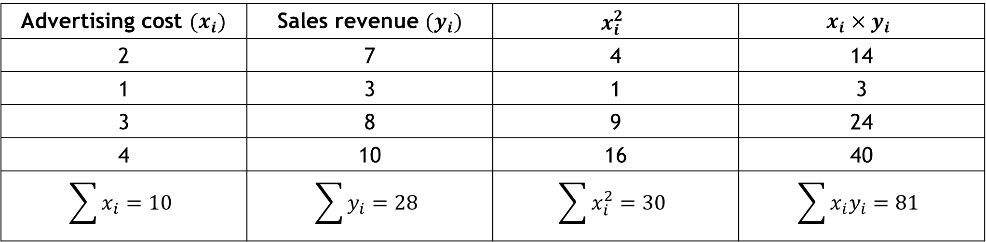
Example
$$\hat{β}=\frac{n\sum{x_{i}y_{i}}−\sum{x_{i}\sum{y_{i}}}}{n\sum{x_{i}^{2}}−{\left(\sum{x_{i}}\right)}^{2}}$$
Advertising cost $(x_{i})$ | Sales revenue $(y_{i})$ | $$x_{i}^{2}$$ | $$x_{i}×y_{i}$$
2 | 7 | 4 | 14
1 | 3 | 1 | 3
3 | 8 | 9 | 24
4 | 10 | 16 | 40
$$\sum{x_{i}}=10$$ | $$\sum{y_{i}}=28$$ | $$\sum{x_{i}^{2}}=30$$ | $$\sum{x_{i}y_{i}=81}$$

Slide 48

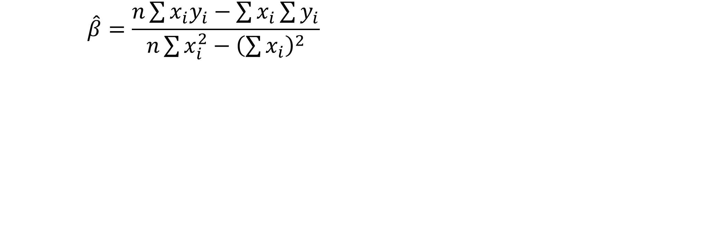

Example
$$\hat{β}=\frac{n\sum{x_{i}y_{i}}−\sum{x_{i}\sum{y_{i}}}}{n\sum{x_{i}^{2}}−{\left(\sum{x_{i}}\right)}^{2}}=\frac{\left(4×81\right)−\left(10×28\right)}{\left(4×30\right)−{\left(10\right)}^{2}}=2.2$$
$$\hat{α}=\overline{Y}−\hat{β}\overline{X}=7−\left(2.2×2.5\right)=1.5$$
$\hat{β}=2.2$means that an increase of $1 million in advertising cost, the average sales revenue will increase $2.2 million
$\hat{α}=1.5$ means that, if there is no advertising cost then average sales revenue would be $1.5 million

Slide 49
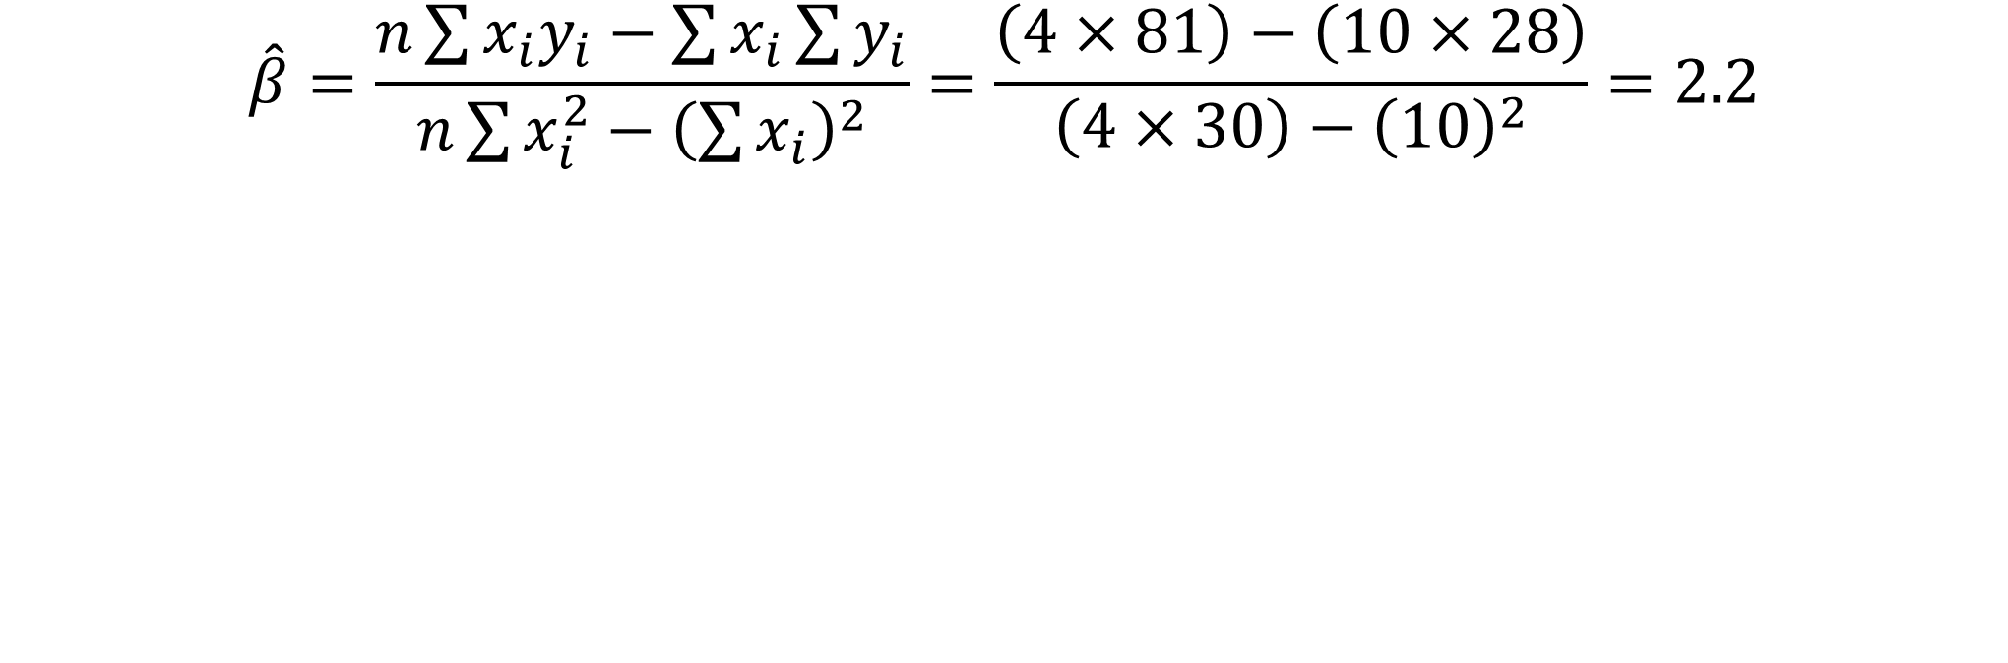
Example
$$\hat{β}=\frac{n\sum{x_{i}y_{i}}−\sum{x_{i}\sum{y_{i}}}}{n\sum{x_{i}^{2}}−{\left(\sum{x_{i}}\right)}^{2}}=\frac{\left(4×81\right)−\left(10×28\right)}{\left(4×30\right)−{\left(10\right)}^{2}}=2.2$$
$$\hat{α}=\overline{Y}−\hat{β}\overline{X}=7−\left(2.2×2.5\right)=1.5$$
$\hat{β}=2.2$means that an increase of $1 million in advertising cost, the average sales revenue will increase $2.2 million
$\hat{α}=1.5$ means that, if there is no advertising cost then average sales revenue would be $1.5 million

Slide 50
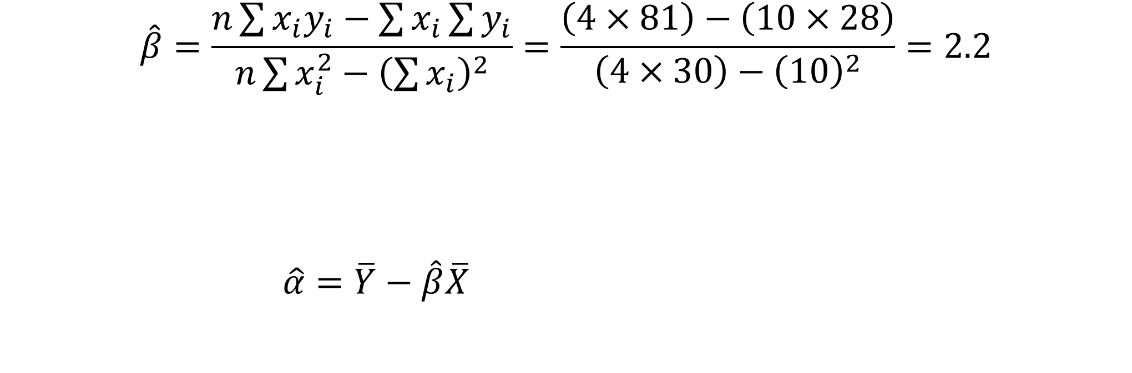
Example
$$\hat{β}=\frac{n\sum{x_{i}y_{i}}−\sum{x_{i}\sum{y_{i}}}}{n\sum{x_{i}^{2}}−{\left(\sum{x_{i}}\right)}^{2}}=\frac{\left(4×81\right)−\left(10×28\right)}{\left(4×30\right)−{\left(10\right)}^{2}}=2.2$$
$$\hat{α}=\overline{Y}−\hat{β}\overline{X}=7−\left(2.2×2.5\right)=1.5$$
$\hat{β}=2.2$means that an increase of $1 million in advertising cost, the average sales revenue will increase $2.2 million
$\hat{α}=1.5$ means that, if there is no advertising cost then average sales revenue would be $1.5 million

Slide 51
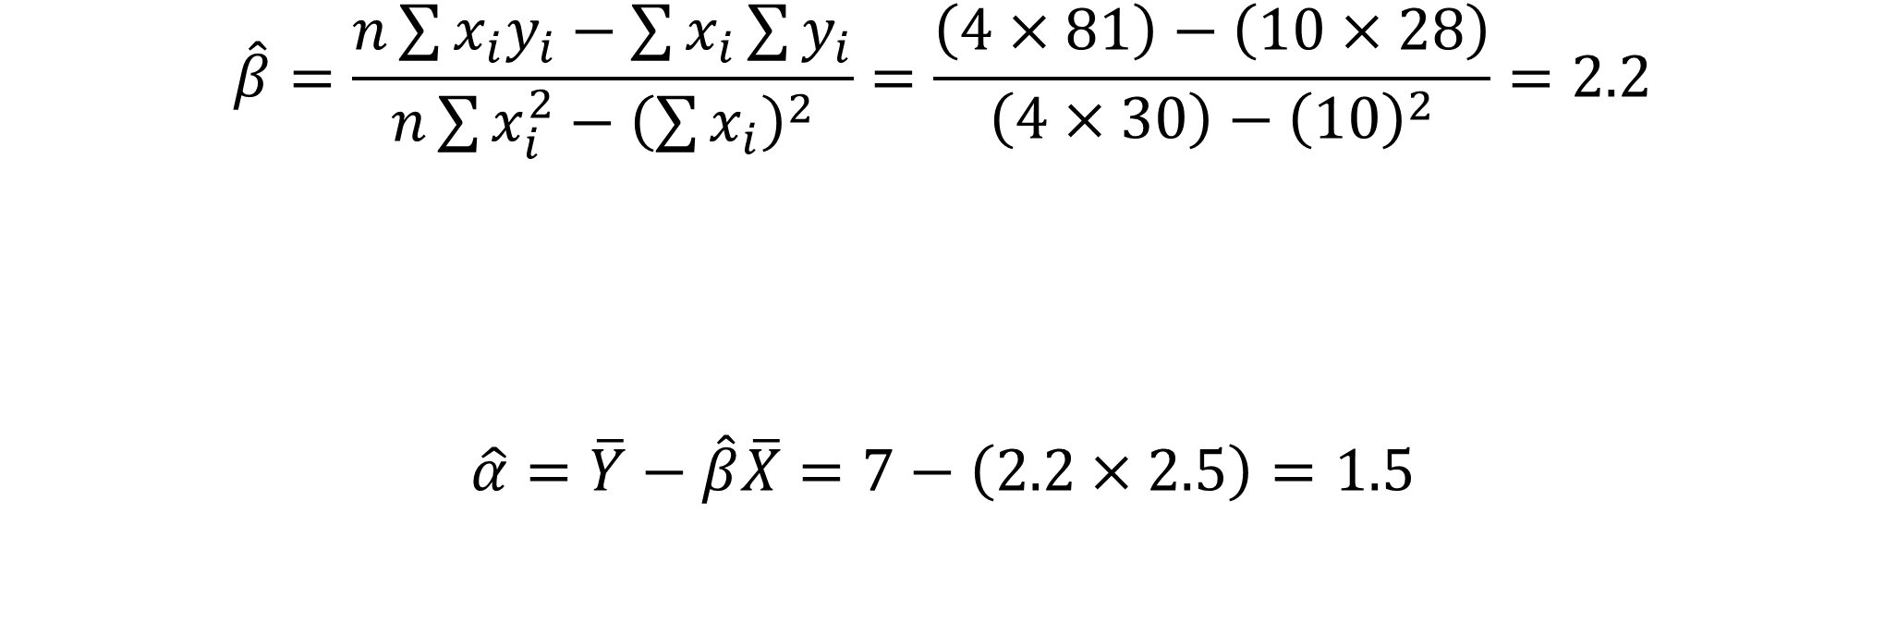
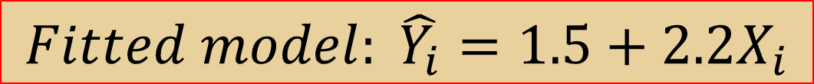
Example
$$Fitted model: \hat{Y_{i}}=1.5+2.2X_{i}$$
$$\hat{β}=\frac{n\sum{x_{i}y_{i}}−\sum{x_{i}\sum{y_{i}}}}{n\sum{x_{i}^{2}}−{\left(\sum{x_{i}}\right)}^{2}}=\frac{\left(4×81\right)−\left(10×28\right)}{\left(4×30\right)−{\left(10\right)}^{2}}=2.2$$
$$\hat{α}=\overline{Y}−\hat{β}\overline{X}=7−\left(2.2×2.5\right)=1.5$$
$\hat{β}=2.2$means that an increase of $1 million in advertising cost, the average sales revenue will increase $2.2 million
$\hat{α}=1.5$ means that, if there is no advertising cost then average sales revenue would be $1.5 million

Slide 52
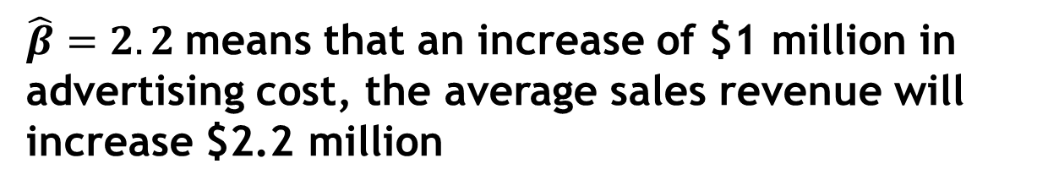
Example
$$Fitted model: \hat{Y_{i}}=1.5+2.2X_{i}$$
$$\hat{β}=\frac{n\sum{x_{i}y_{i}}−\sum{x_{i}\sum{y_{i}}}}{n\sum{x_{i}^{2}}−{\left(\sum{x_{i}}\right)}^{2}}=\frac{\left(4×81\right)−\left(10×28\right)}{\left(4×30\right)−{\left(10\right)}^{2}}=2.2$$
$$\hat{α}=\overline{Y}−\hat{β}\overline{X}=7−\left(2.2×2.5\right)=1.5$$
$\hat{β}=2.2$means that an increase of $1 million in advertising cost, the average sales revenue will increase $2.2 million
$\hat{α}=1.5$ means that, if there is no advertising cost then average sales revenue would be $1.5 million

Slide 53
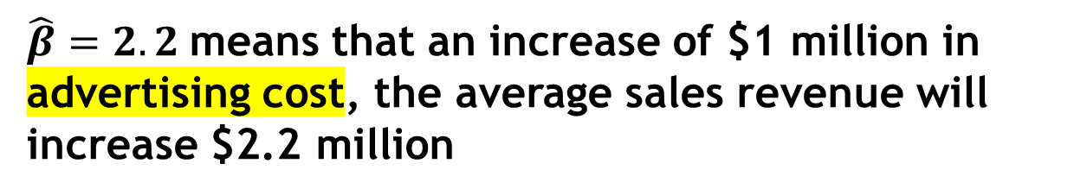
Example
$$Fitted model: \hat{Y_{i}}=1.5+2.2X_{i}$$
$$\hat{β}=\frac{n\sum{x_{i}y_{i}}−\sum{x_{i}\sum{y_{i}}}}{n\sum{x_{i}^{2}}−{\left(\sum{x_{i}}\right)}^{2}}=\frac{\left(4×81\right)−\left(10×28\right)}{\left(4×30\right)−{\left(10\right)}^{2}}=2.2$$
$$\hat{α}=\overline{Y}−\hat{β}\overline{X}=7−\left(2.2×2.5\right)=1.5$$
$\hat{β}=2.2$means that an increase of $1 million in advertising cost, the average sales revenue will increase $2.2 million
$\hat{α}=1.5$ means that, if there is no advertising cost then average sales revenue would be $1.5 million

Slide 54
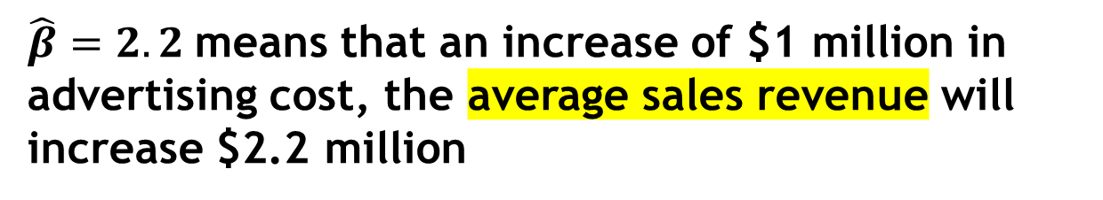
Example
$$Fitted model: \hat{Y_{i}}=1.5+2.2X_{i}$$
$$\hat{β}=\frac{n\sum{x_{i}y_{i}}−\sum{x_{i}\sum{y_{i}}}}{n\sum{x_{i}^{2}}−{\left(\sum{x_{i}}\right)}^{2}}=\frac{\left(4×81\right)−\left(10×28\right)}{\left(4×30\right)−{\left(10\right)}^{2}}=2.2$$
$$\hat{α}=\overline{Y}−\hat{β}\overline{X}=7−\left(2.2×2.5\right)=1.5$$
$\hat{β}=2.2$means that an increase of $1 million in advertising cost, the average sales revenue will increase $2.2 million
$\hat{α}=1.5$ means that, if there is no advertising cost then average sales revenue would be $1.5 million

Slide 55
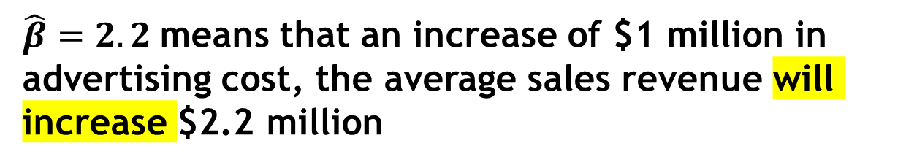
Example
$$Fitted model: \hat{Y_{i}}=1.5+2.2X_{i}$$
$$\hat{β}=\frac{n\sum{x_{i}y_{i}}−\sum{x_{i}\sum{y_{i}}}}{n\sum{x_{i}^{2}}−{\left(\sum{x_{i}}\right)}^{2}}=\frac{\left(4×81\right)−\left(10×28\right)}{\left(4×30\right)−{\left(10\right)}^{2}}=2.2$$
$$\hat{α}=\overline{Y}−\hat{β}\overline{X}=7−\left(2.2×2.5\right)=1.5$$
$\hat{β}=2.2$means that an increase of $1 million in advertising cost, the average sales revenue will increase $2.2 million
$\hat{α}=1.5$ means that, if there is no advertising cost then average sales revenue would be $1.5 million

Slide 56
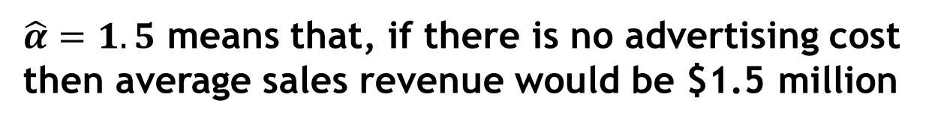
Example
$$Fitted model: \hat{Y_{i}}=1.5+2.2X_{i}$$
$$If X=9: \hat{Y_{i}}=1.5+2.2×9=21.3$$
$$\hat{β}=\frac{n\sum{x_{i}y_{i}}−\sum{x_{i}\sum{y_{i}}}}{n\sum{x_{i}^{2}}−{\left(\sum{x_{i}}\right)}^{2}}=\frac{\left(4×81\right)−\left(10×28\right)}{\left(4×30\right)−{\left(10\right)}^{2}}=2.2$$
$$\hat{α}=\overline{Y}−\hat{β}\overline{X}=7−\left(2.2×2.5\right)=1.5$$
$\hat{β}=2.2$means that an increase of $1 million in advertising cost, the average sales revenue will increase $2.2 million
$\hat{α}=1.5$ means that, if there is no advertising cost then average sales revenue would be $1.5 million

Slide 57
Thank You

